Slide 1
Shooting down uncertainty: KALMAN FILTERS and Ballistic missile defense
Very Brief Introduction and q/kdb+ Implementation
Mark B. Lefevre

Slide 2
The KALMAN FILTER
A statistical algorithm that produces accurate estimates of unknown state variables in the presence of noise and other inaccuracies
Recursive and can be used in real-time
Uses a 2 Step Process
Predict – estimate current state variables
Update – use next measurement to update estimate using a weighted average
Noise Smoothing
State Estimation
Quick Convergence
Notes:
Bayesian Connection
-Have a belief about the state of the world
-Ingest new measurements/data
-If the new data contradicts my belief,
I am less certain about my belief and I slightly update my belief
-If it supports my belief
I am more certain and I don’t update
-Useful when you already have a model

Slide 3
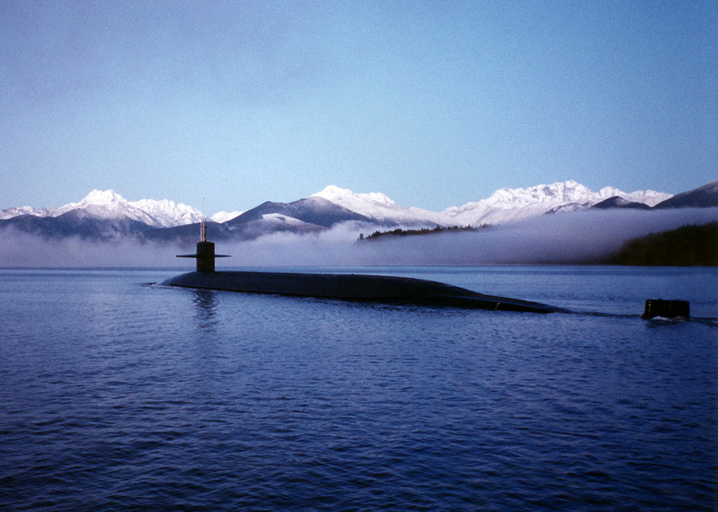
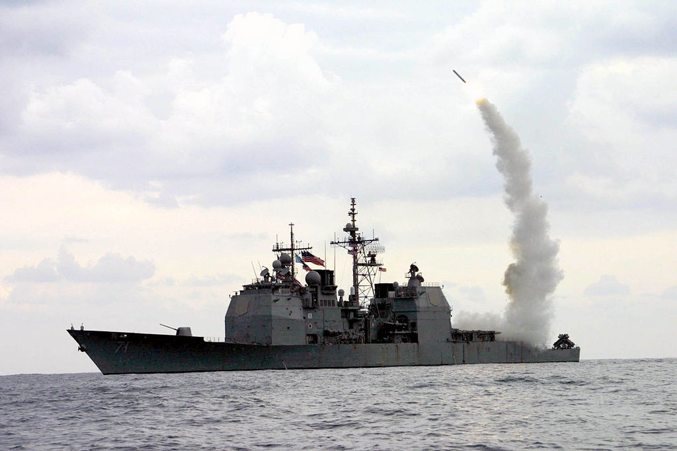
APPLICATIONS of KALMAN FILTERs
Target tracking
Satellites, Missiles, Aircraft, Spacecraft, UAVs
Guidance/Navigation
ex. GPS
Sensor fusion
ex. RADAR, LIDAR, LASER
Economics
Finance
Many more
Notes:
Aeronautics
navigation of US Navy ballistic missile submarines
guidance and navigation of US Navy Tomahawk missile
US AF Air Launched Cruise Missile
Robotics, autonomous vehicles
Economics
Estimate parameters for ARMA models
Modeling regime changes
Forecasting economic indicators
Finance
Simple example: replace moving averages
Estimate beta (which is an extremely noisy quantity using returns)
Can compute rolling estimates
Avoids having to choose a finite lookup window
Dr. Aidan O’Mahoney has a cool blog
http://www.thealgoengineer.com/2014/online_linear_regression_kalman_filter/
Subject of lots of academic research and widely applied in many different industries

Slide 4
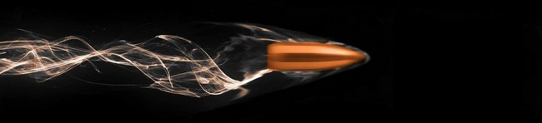
Realistic Ballistic Trajectory
Aerodynamic Drag
Altitude Effects
Changes in Air Density
Decrease in Gravity
Winds/Weather
Coriolis Effect
Earth Curvature
Target Motion
Internal Propulsion
Notes:
Aerodynamic drag is also known as air resistance
Winds/Weather
Gusty near the ground
Fast high-altitude jet stream
Humidity, Precipitation
Coriolis Effect is the deflection of the trajectory due to the spinning of the Earth. Even in long-range sniping this becomes important at around 1000 meters. Targets can rise or drop about 6 inches depending if you are shooting east (rise) or west (fall). North/South results in 3 inches move left (Southern Hemisphere) or right (Northern Hemisphere).
Earth Curvature Earth is actually an oblate spheroid. The radius at the equator is greater than at the poles.
ICBMs typically have multiple stages. The LGM-118A Peacekeeper has 4 propulsion stages. 3, solid-fuel and 1, post-boost liquid-fuel for velocity and attitude correction.
Ballistic Trajectory is also called Projectile Motion
Timed exposure shows 10 MK-21 re-entry vehicles (RV) approaching an open-ocean impact zone near Kwajalein Atoll during a flight test
These would ride inside an American LGM-118A Peacekeeper ICBM
Typical ICBMs have a range of 10k km and a speed of around 7km/s
Image Source:
https://en.wikipedia.org/wiki/File:MIRV-Reentry.jpg

Slide 5


Simple Projectile Motion
Instantaneous Launch
No Aerodynamic Drag, Winds
Only Acceleration due to Gravity
$$g=−9.8\frac{m}{s^{2}}$$
Equations
Position
$$x={x_{0}+v}_{0}t\cos{θ}$$
$$y={y_{0}+v}_{0}t\sin{θ}+\frac{1}{2}gt^{2}$$
Velocity
$$v_{x}=v_{0}\cos{θ}$$
$$v_{y}=v_{0}\sin{θ}+gt$$
Acceleration
$$a_{x}=0 \\ a_{y}=g$$
Notes:
Ballistic Trajectory is also called Projectile Motion
This is a high school physic refresher in projectile motion
Projectile motion can be simply decomposed into independent motions in the x and y direction
Note that g here is defined as a negative so the terms due to acceleration are added
Galileo determined that the curved path is parabolic
The continuous line is calculated using these equations. The dots are calculated using a discretized state space model which I will introduce.

Slide 6

Measurement Problem
Actual state of the system is not directly observable
Any measurement of the system outputs are unavoidably noisy
Process Model
$$x_{k}=Ax_{k−1}+Bu_{k}+w_{k−1}$$
Measurement Model
$$z_{k}=Hx_{k}+v_{k}$$
Process and Measurement Noise
$$p\left(w\right)\sim N\left(0,Q\right) \\ p\left(v\right)\sim N(0,R)$$
Notes:
We want to estimate internal states only by observing the outputs of the system
We use a state-space model
The process model is a linear stochastic difference equation which models the transition of the internal state
The measurement model is a linear stochastic equation which represents the measure of the current state
The measurement does not have to be all the state element and can be any linear combinations of them
Measurement errors can be due to sensor limitations, electrical noise, atmospheric conditions, etc.
Actual state transitions are completely unknown
Process models intentionally incorporate notions of random motion for the reasons mentions in realistic ballistic trajectories
w_k-1 and v_k are random variables
Assume that noises are independent zero mean Gaussians

Slide 7


State-Space Model
Discretize Equations
Use matrix notation
$$x_{k}=Ax_{k−1}+Bu_{k}$$
A, State Transition Model
B, Control-Input Model
$x_{k}$, current state
$x_{k−1}$, previous state
$u_{k}$, static vector
State Vector Example
$$x_{k}=\left[\begin{matrix}x \\ y \\ vx \\ vy\end{matrix}\right]$$
System state at a particular time
x, y: Target position
vx, vy: Target velocity
Potential extensions
z dimension
Target acceleration
Notes:
Note the state space model doesn’t include the error
State example is just an example. Here our state contains the x,y position and the x,y velocities.
It could be anything depending on your model.
In a financial context, it could be price, volatility, interest rate, volatility, liquidity, dividend yield (equities), maturity (fixed income)

Slide 8
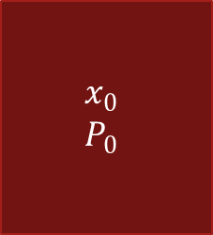



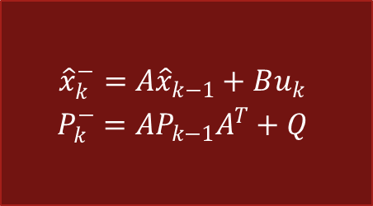
A Kalman Filter
Initial State
Predict
Choice an Initial State
Predict
Project the state
Project the error covariance
Correct
Compute the Kalman Gain
Update estimate with measurement
Update the error covariance
$$\begin{matrix}x_{0} \\ P_{0}\end{matrix}$$
$$\begin{matrix}{\hat{x}}_{k}^{−}=A{\hat{x}}_{k−1}+Bu_{k} \\ P_{k}^{−}=AP_{k−1}A^{T}+Q\end{matrix}$$
Correct
$$\begin{matrix}K_{k}=\frac{P_{k}^{−}H^{T}}{HP_{k}^{−}H^{T}+R} \\ \left.{\hat{x}}_{k}={\hat{x}}_{k}^{−}+K_{k}(z_{k}−H{\hat{x}}_{k}^{−}\right) \\ P_{k}=\left(1−K_{k}H\right)P_{k}^{−}\end{matrix}$$
$${\hat{x}}_{k}$$
$$z_{k}$$
Notes:
Kalman filters are based on linear dynamical systems discretized in the time domain
Examine the Kalman Gain in detail in 2 slides

Slide 9

DISCRETE Kalman Filter
Predictor-Corrector Estimator
Maintains 2 statistical moments (state, error covariance)
Minimizes Error Covariance
Define a priori and a posteriori Estimate Errors
$$e_{k}^{−}≡x_{k}−{\hat{x}}_{k}^{−}$$
$$e_{k}≡x_{k}−{\hat{x}}_{k}$$
Estimate a priori and a posteriori Covariances
$$P_{k}^{−}=E\left[e_{k}^{−}{e_{k}^{−}}^{T}\right]$$
$$P_{k}=E\left[e_{k}{e_{k}^{−}}^{T}\right]$$
Compute a posteriori State Estimate
$${\hat{x}}_{k}={\hat{x}}_{k}^{−}+K(z_{k}−H{\hat{x}}_{k}^{−})$$
Notes:
Compute a prosteriori state estimate as a linear combination of a prior estimate and weighted difference between an actual measurement and a measurement prediction
Difference term in red is called the measurement innovation or the residual.
The residual is the discrepancy between the predicted measurement and the actual measurement

Slide 10

Kalman Gain
Kalman Gain is Chosen to Minimize a posteriori Error Covariance
$K_{k}=\frac{P_{k}^{−}H^{T}}{HP_{k}^{−}H^{T}+R}$
Blending Factor which weights the a priori Estimated State and the Measurement
Value is between 0 and 1
As Measurement Error Covariance R tends to 0
Residual has more weight
As a priori Estimated Error Covariance $P_{k}^{−}$ tends to 0
a priori Estimated State has more weight
Notes:
Kalman Gain decides the relative weight given to the measurements and current state estimate
High gain (close to 1), the filter places more weight on the most recent measurements, and thus is more reactive, could give jumpy trajectory estimates
Low gain (close to 0), the filter follows the model predictions more closely. This effectively smooths out noise but decrease the responsiveness

Slide 11
q/KDB+ Code
/ Constants
g:9.81; / gravity m/s^2
/ Time steps
dt:0.1;
/ [b]egin; [e]nd; [s]tep
arange:{[b;e;s] b+s*til "j"$-[e;b]%s};
times:arange[0;10;dt];
/ Initial conditions
x0:0; y0:0; vx0:50; vy0:50; / pos in m; vel in m/s
/ Actual trajectory
atraj:{[g;x0;y0;vx0;vy0;t]
x:x0+vx0*t; / x pos
y:-[y0+vy0*t;0.5*g*t*t]; / y pos y0+vy0*t-0.5*g*t^2
vx:vx0; / x vel (no air resistance)
vy:vy0-g*t; / y vel (gravity but no air res)
(x;y;vx;vy)};
act_traj:atraj[g;x0;y0;vx0;vy0;];
/ Simulate actual trajectory
true_traj:act_traj[times]; / use the projection
Notes:
Over the next four slides, I will show the q code to implement a Kalman Filter for a simple ballistic target.
It is not important to understand each line, but perhaps you can understand the broad strokes. Much of the code is setting up data, initialization and writing it out for plotting in Python.
The left hand side establishes some constants, time steps and initial conditions.
The right hand side defines a generic function to compute the actual trajectory given a time.
It then defines a projection for these specific initial conditions. It then simulates the actual trajectory for the all the times.

Slide 12
q/KDB+ Code
/ Simulate measurements
pos_meas_noise:1.0; / standard dev of position measurements
vel_meas_noise:0.5; / standard dev of velocity measurements
/ Use Nick Psaris Box Muller algorithm for
/ generating pairs of independent, standard normally distributed
/ random variables from uniformly distributed random variables
meas_traj:true_traj+
*[(pos_meas_noise;vel_meas_noise)0 0 1 1;] / scale std dev
(4 0N)#.stat.bm*[4;count times]?1f; / measurement errors
id:{(2#x)#1,x#0}; / Identity matrix from qphrasebook
/ Kalman Filter
/ Initialization
/ State vector [x, y, vx, vy]
x_est:(4;count times)#0f;
P:"f"$id 4; / State Covariance matrix
R:*[(pos_meas_noise;vel_meas_noise)0 0 1 1;]
"f"$id 4; / Measurement Noise Covariance
Q:0.005*"f"$id 4; / Process Noise Covariance
F:"f"$id 4; / State Transition Matrix
F:(@[F 0;2;+;dt];@[F 1;3;+;dt];F 2;F 3);
H:"f"$id 4; / Measurement Matrix (pos and vel)
G:(4;4;count times)#0f;
Notes:
The code on the left hand side defines some noise parameters and computes a times series of noisy measurements.
The measurement noise is normally distributed.
I take advantage of the Box Muller algorithm for computing pairs of standard normally distributed variables from uniform draws.
Once the standard derivations are properly scaled, it is added to the true state.
On the right hand side, I define a function from the q phrasebook and set up some initializations.

Slide 13
q/KDB+ Code
/ KF Prediction Step
// Predict next state using prev state and the F, state transition matrix
// Predict state uncertainty (update P, covariance matrix using Q, process noise
predictState:{[F;ps;P;Q]
ns:F$ps; / predicted next state
nP:$[F;$[P;flip F]]+Q; / predicted next P
(ns;nP)
};
// Kalman Gain (K) weight of measurement vs prediction
// done in the update step
computeKalmanGain:{[H;pP;R]
S:$[H;$[pP;flip H]]+R; / intermediate matrix for inversion
K:$[pP;$[flip H;inv S]] / inv uses LU decomposition
};
/ KF Update Step
// Update corrects predicted state with new measurement
// Kalman Gain (K) adjusts predicted state based on the measurement residual
// Update state estimate and uncertainty (covariance)
updateStateEstimate:{[H;pP;R;ms;ps]
id:{(2#x)#1,x#0};
I:"f"$id 4; / Identity Matrix
K:computeKalmanGain[H;pP;R];
y:ms-$[H;ps]; / measurement residuals
es:ps+$[K;y]; / new state estimat
P:$[I-$[K;H];pP];
(K;es;P)
};
Notes:
This slide contains the meat of the Kalman Filter. There are two basic steps in the Kalman Filter: prediction and update. There is a third function defined here for computing the Kalman Gain which I factored out for maintainability.

Slide 14
q/KDB+ Code
// Run the Kalman Filter
idx:0;
res:();
ps:(); pP:();
es:(); cP:();
while[idx<-1+count times;
idx+:1;
res:predictState[F;x_est[;idx-1];P;Q];
ps:res 0; pP:P:res 1;
res:updateStateEstimate[H;pP;R;meas_traj[;idx];ps];
G[;;idx]:res 0; x_est[;idx]:res 1; P:res 2;
];
// Create table(s) for visualization
tms:flip ![enlist `time;enlist times];
est:flip ![`x`y`xv`yv;x_est];
true:flip `truex`truey`truexv`trueyv!true_traj;
meas:flip `measx`measy`measxv`measyv!meas_traj;
kgains:flip `gainx`gainy`gainxv`gainyv!{G[x;x;::]} each til 4;
data:(,')over(tms;est;true;meas;kgains);
save `:./data.csv;
Notes:
Once all the initialization and function definitions are complete, we want to run the Kalman Filter over the measured values. Although good q programmers avoid loops, I thought it would be clearer to iterate over time using a while loop.
The right hand side creates a bunch of tables, joins them together sideways and writes out a data.csv.
In a previous iteration of this presentation I used Excel to graph the results, but am now using matplotlib in Python

Slide 15
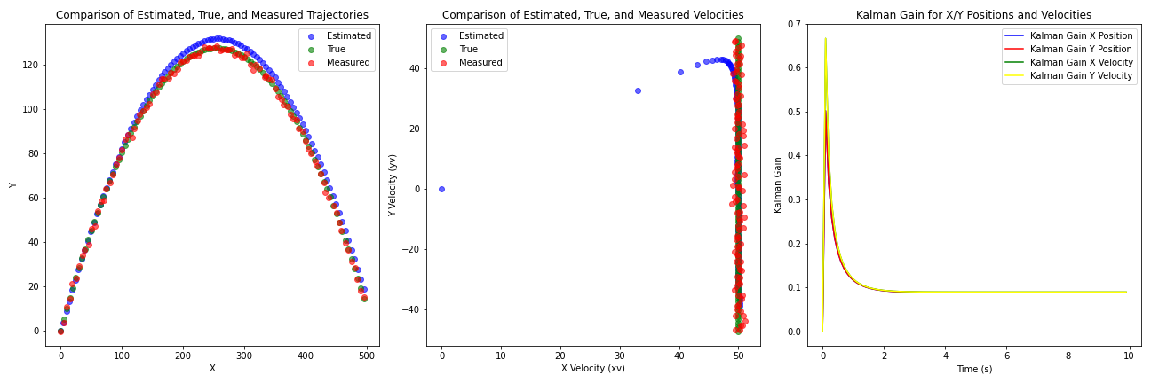
Kalman Filter outputs
Notes:
These results were created with q/kdb+ code, saved to a csv file and plotted in Python using matplotlib.
There is an element of randomness, so unless your seed value was the same, the results will be slightly different.
In the reference q/kdb code, the seed is set for reproducibility.
The first plot shows the true location in the x and y dimensions in green.
The red dots are the measured position which includes measurement noise.
The blue dots are the estimated positions.
The middle plot shows the true velocities in green. The ballistic target starts with velocities in both directions of 50 m/s. The x velocity is unchanged as we are not simulating are drag. The y velocity decreases under the influence of gravity.
As in the position measurement, there is noise in the velocity measurement although we have set it to a different value.
The velocity estimate begins at 0,0 and quickly starts to converge closer to the true velocities.
The third plot shows the Kalman gain for the positions and velocities. The Kalman gain is a mxn matrix where the m is the number of state variables and n is the number of measurements. The diagonal elements of the Kalman Gain matrix represent the gain for each individual state variable (e.g., position, velocity, etc.). These diagonal elements determine how much of a correction will be applied to the state estimate for each state variable based on the measurement residuals. Larger diagonal elements indicate more trust in the measurements for that specific state variable, and smaller diagonal elements indicate more trust in the model predictions. The model initially places more trust in the measurements, but over time, it starts relying more on the estimated state. In the beginning, it comparatively trusts the velocity measurements more that the position measurement.

Slide 16
EXTENSIONS
Extended Kalman Filter (EKF)
Standard KF applied to first order Taylor’s approximation on non-linear state-space model
Unscented Kalman Filter (UKF)
Uses Sigma Points to take additional weighted points on source Gaussian and map them to target Gaussian through a non-linear function
Central Kalman Filter (CKF)
Very computational expensive
Distributed Kalman Filter (DKF)
Uses distributed microfilters and a consensus filter
Ensemble Kalman Filter (EnKF)
Notes:
Kalman Filter assumes linearity
Measurement is a linear function of state
Next state is a linear function of previous state

Slide 17
Summary
Given a linear dynamical system, a Kalman Filter finds an optimal estimate of the state vector
Optimal in a least squares sense
Memory efficient
Extremely Fast
In addition to state, provides estimation quality information
Robust
Easy to implement in q/KDB+
Notes:
It is optimal if:
Model perfectly matches the real system
Noises are uncorrelated and white
Covariances of white noise are known
Robust
-Stable given common conditions and forgiving in many way
Give special thanks to
Dr. Chris Kubelek for inspiring my initial interest in Kalman Filters
Dr. Hizuru Konishi for being a fantastic sempai and mentor at MUFG Bank
Dr. Laurent Calvet at EDHEC

